Slide 1
Two-Way Independent ANOVA (GLM 3)
Chapter 13

Slide 2
What is Two-Way Independent ANOVA?
Two Independent Variables
Two-way = 2 Independent variables
Three-way = 3 Independent variables
Different participants in all conditions.
Independent = ‘different participants’
Several Independent Variables is known as a factorial design

Slide 3
What is Two-Way Independent ANOVA?
Often people call these:
Two-way between subjects ANOVA
Indicates all the IVs are between
Two-way factorial ANOVA
Although that’s a bit redundant
Just Factorial ANOVA

Slide 4
Other ANOVAs
Two-way repeated measures ANOVA
Indicates all IVs are repeated
Two-way mixed ANOVA
Indicates 1 IV = between, 1 IV = repeated

Slide 5
Benefit of Factorial Designs
We can look at how variables Interact.
Interactions
Show how the effects of one IV might depend on the effects of another
Are often more interesting than main effects.
Examples
Interaction between hangover and lecture topic on sleeping during lectures.
A hangover might have more effect on sleepiness during a stats lecture than during a clinical one.

Slide 6
Assumptions
Same as one-way ANOVAs
Accuracy, Missing, Outliers
Normal
Linear
Homogeneity
Homoscedasticity

Slide 7
Back to levels/conditions
Remember:
IVs: each individual IV has levels.
The combinations of levels are the conditions.
Interactions examine the conditions.
(across or down)

Slide 8
Example
IV: Gender of participant
Levels: Male/Female
IV: Sport attended
Levels: None, volleyball, football
DV: Satisfaction with athletics on campus

Slide 10
SS Total
Same as one-way ANOVA
Each person minus the grand mean
Dftotal = N – 1
Remember N = total sample size

Slide 11
SS Model
Remember that SS model =
My group mean (condition) – grand mean
But now we have several groups that I’m in – and this formula ignores that these conditions are structured by IV, so we are going to break this down by IV instead of pretending they are all the same IV.

Slide 12
SS A = SS gender
Same formula as SS model … but ignoring the other variable.
Level mean – grand mean
DF a = (k-1)
K = levels

Slide 13
SS B = SS sport
Same formula as SS model … but ignoring the other variable.
Level mean – grand mean
DF b = (k-1)

Slide 14
Marginal Means
These “level means” are considered marginal means.

Slide 15
SS AXB = interaction
DF AXB = Dfa X DFb

Slide 16
SS_{R} = error
This formula doesn’t change – average variance across groups.
Each participant – my condition mean
Notes:
The residual sum of squares is calculated in the same way as for one-way ANOVA and again represents individual differences in performance or the variance that can’t be explained by factors that were systematically manipulated. We saw in one-way ANOVA that the value is calculated by taking the squared error between each data point and its corresponding group mean. An alternative way to express this was as in equation 1 in the slide.
So, we use the individual variances of each group and multiply them by one less than the number of people within the group (n). We have the individual group variances in our original table of data (first page of this handout) and there were 8 people in each group (therefore, n = 8) and so the equation becomes the second equation on the slide.
The degrees of freedom for each group will be one less than the number of scores per group (i.e. 7). Therefore, if we add the sums of squares for each group, we get a total of 6 × 7 = 42.

Slide 17
How to run SPSS
You cannot do this analysis through the one-way menu.
Therefore, we will use GLM for everything else ANOVA related.

Slide 18
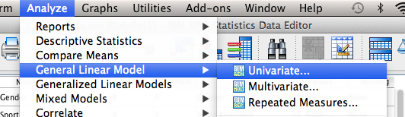
How to run SPSS
Analyze > GLM > Univariate

Slide 19
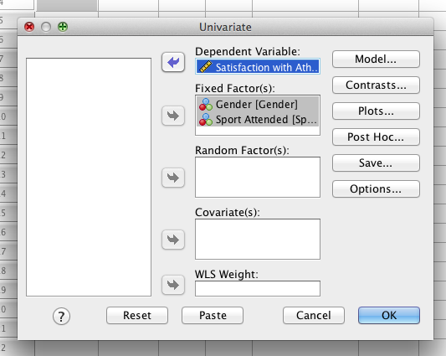
How to run SPSS
Both IVs go in fixed factor.
DV still goes in
dependent variable box.

Slide 20
How to run SPSS
Click options.
Move over all the variables.
Click estimates of effect size, homogeneity, descriptives.

Slide 21
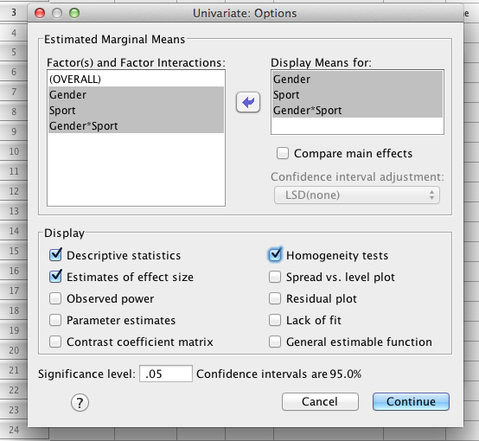
How to run SPSS

Slide 22
How to run SPSS
Click post hoc
Move over the variables
Click Tukey.
(this is my favorite, but remember you have lots of options).

Slide 23
How to run SPSS
Option: click plots
Put one in horizontal axis
Put the other in different lines
Hit add
These aren’t the graphs you include for journals, but can help you see the interaction.

Slide 24
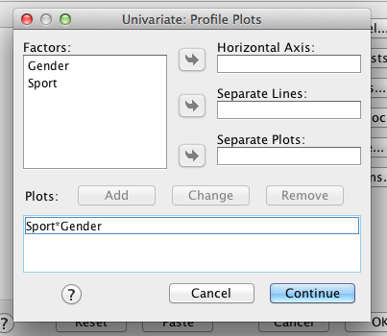
How to run SPSS

Slide 25

How to run SPSS
WARNING!
Any time you try to run a post hoc for an IV with only TWO levels, you will get this warning.
IMPORTANT:
You do NOT run post hocs on IVs that only have two levels. You just look at the means to compare them.

Slide 26
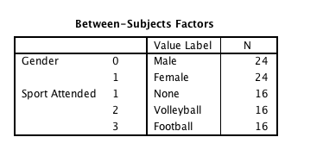
How to run SPSS
N values for each level combination

Slide 27
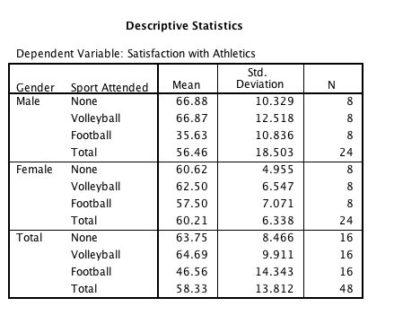
How to run SPSS
Means and SDs (useful for calculating cohen’s d).

Slide 28
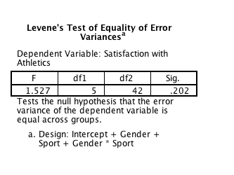
How to run SPSS
Levene’s test for homogeneity

Slide 29
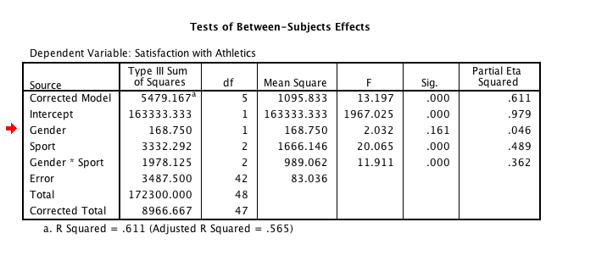
How to run SPSS

Slide 30
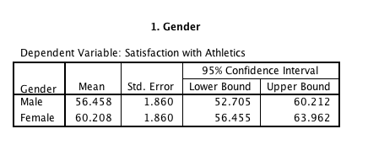
How to run SPSS
Gender:
F(1, 42) = 2.03, p = .16, partial n² = .05

Slide 31
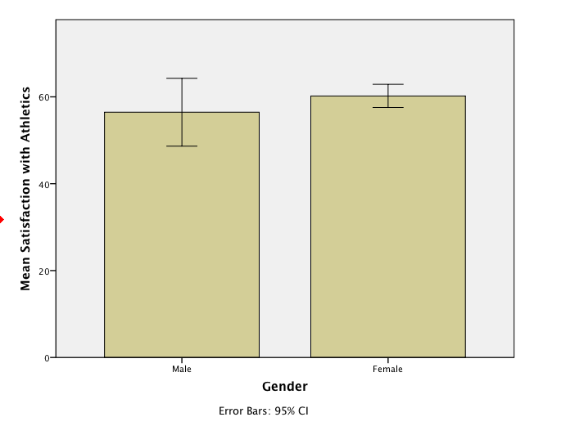
Gender marginal effect

Slide 32
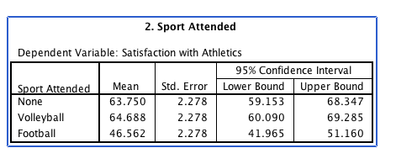
How to run SPSS
Sport
F(2, 42) = 20.07, p <.001, partial n² = .49

Slide 33
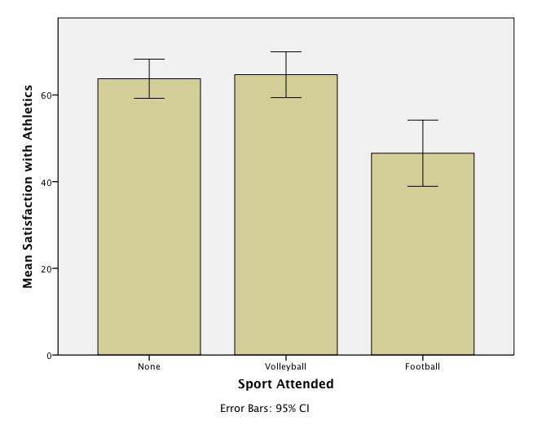
Sport marginal effect

Slide 34
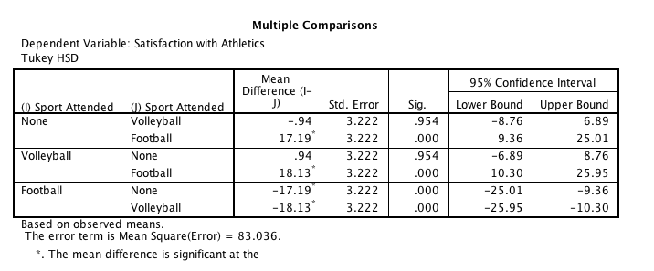
How to run SPSS

Slide 35
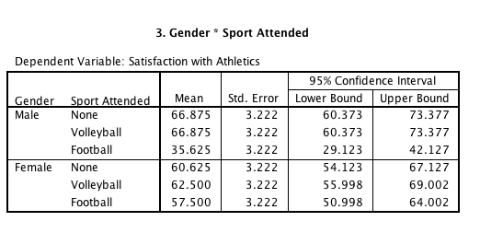
How to run SPSS
Interaction
F(2, 42) = 11.91, p <.001, n² = .36

Slide 36
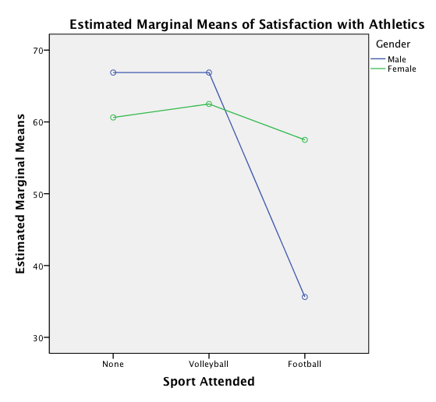
How to run SPSS

Slide 37
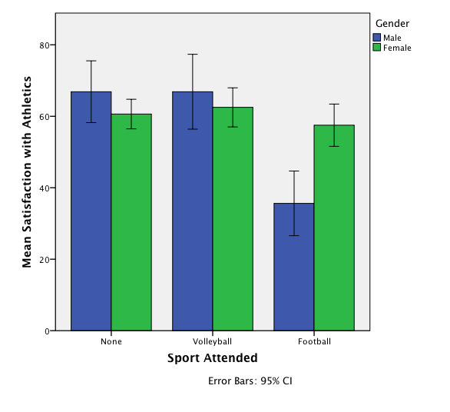
Interaction (this graph is your figure)

Slide 38
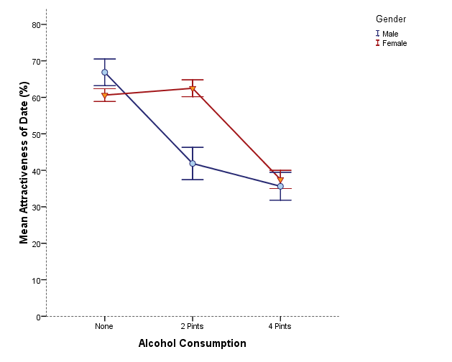
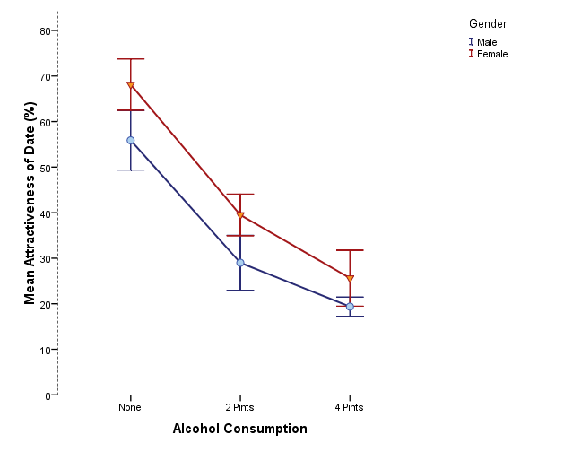
Is there likely to be a significant interaction effect?
Yes
No

Slide 39
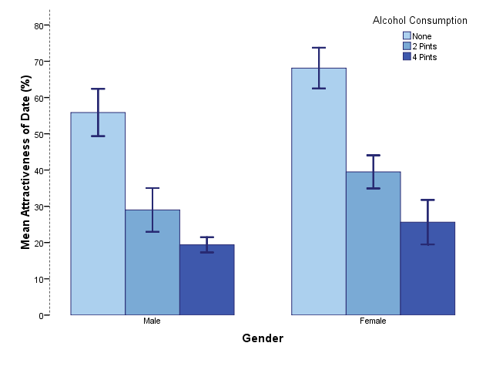
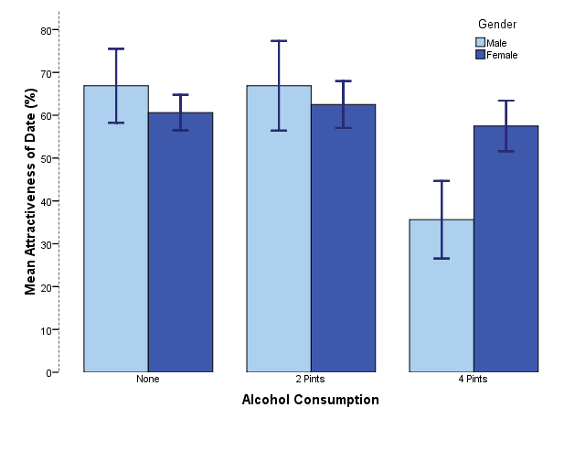
Is there likely to be a significant interaction effect?
No
Yes

Slide 40
Go through examples here
A effect only
B effect only
AXB effect only
All three!
None.

Slide 41
Interpreting graphs
Flat lines = no effect
Parallel lines = no interaction
Un-separated lines = no effect

Slide 42
Interaction = What Now?
Simple effects analysis
A concern:
Type 1 error rate
Back to familywise vs experimentwise

Slide 43
Interaction = What Now?
Suggestions:
A lot of people will not run the MAIN EFFECTS post hoc analyses (the ones you can get automatically) when the interaction is significant
Because the conditions matter … so why only look at the levels?
However, sometimes people still run the main effects post hocs for smaller designs.

Slide 44
Interaction = What Now?
How to run a simple effects analysis:
Go across OR down, but not both.
Pick the direction with the smaller number of levels.
(or stick with your hypothesis).

Slide 45
Interaction = What Now?
How to run a simple effects analysis:
The book suggests using SPSS syntax. ICK.
Back to split file!

Slide 46
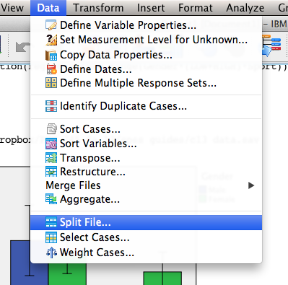
Interaction = What Now?
Figure which conditions you are comparing → split the other variable.
Data > split file.
Move over the variable you are NOT comparing.

Slide 47
Interaction = What Now?
Since this is between subjects = independent t-test
Analyze > compare means > independent samples
Move over the non-split variable into grouping variable
Move your DV into test variable
Define groups (0,1 in this example)
Hit ok.

Slide 48
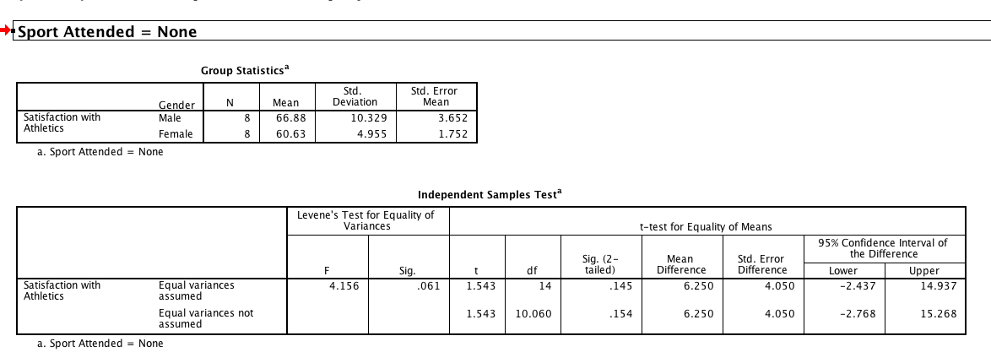
Interaction = What Now?

Slide 49
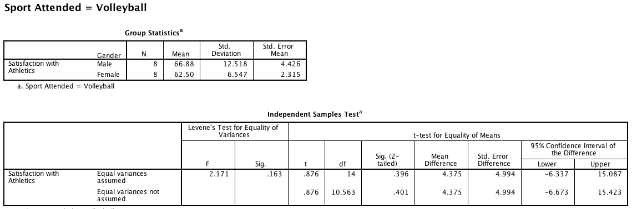
Interaction = What Now?

Slide 50
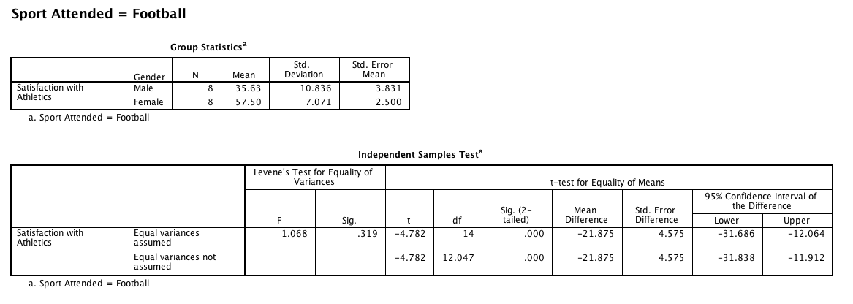
Interaction = What Now?

Slide 51
Interaction = What Now?
Does that control for type 1 error?
No, because it’s just an independent t-test.
So we would need to control for type 1 (back to family wise or experiment wise).

Slide 52
Interaction = What Now?
Calculate Tukey’s (or whichever one you want to use to match your post hoc test).
Q = number of conditions (6 means)
4.23 (using df 40 closest to 42)
Sqrt(83.04 / 8 people per cell)
= 13.62
Check out the mean differences.

Slide 53
Effect sizes
Most common: Partial eta squared for each omnibus F test
Cohen’s d (hedges g) for each post hoc test, since you are comparing two groups means at a time.

Slide 54
Effect sizes
Side note:
For R/eta
Small = .01
Medium = .09
Large = .25

Slide 55
Example write ups
Are in the book, but should include:
Omnibus test for IV1
Omnibus test for IV2
Omnibus test for Interaction
Any post hoc tests.

Slide 56
Example write ups
Some people structure like this:
IV1 F test → post hoc IV1
IV2 F test → post hoc IV2
Interaction F test → post hoc interaction
Figure
But that doesn’t work if you don’t want to do the post hocs because of the interaction
IV1 F, IV2 F, Interaction F
Post hoc tests
Figure

